Slide 1
Principles of Drug Discovery
Lecture 3: Drug Targets
Notes:
4/29/17
1
1

Slide 2
What is a drug target?
Modern drug discovery aims at understanding diseases and symptoms on the molecular level and to modulate distinct proteins in signaling pathways.
Disease/Symptom
Molecular Mechanism
Identify a Way to Influence the Molecular Mechanism
High Blood Pressure
Understand how Blood Pressure is Regulated
Modulate the Mechanism(s) which lead to Blood Pressure Increase

Slide 3
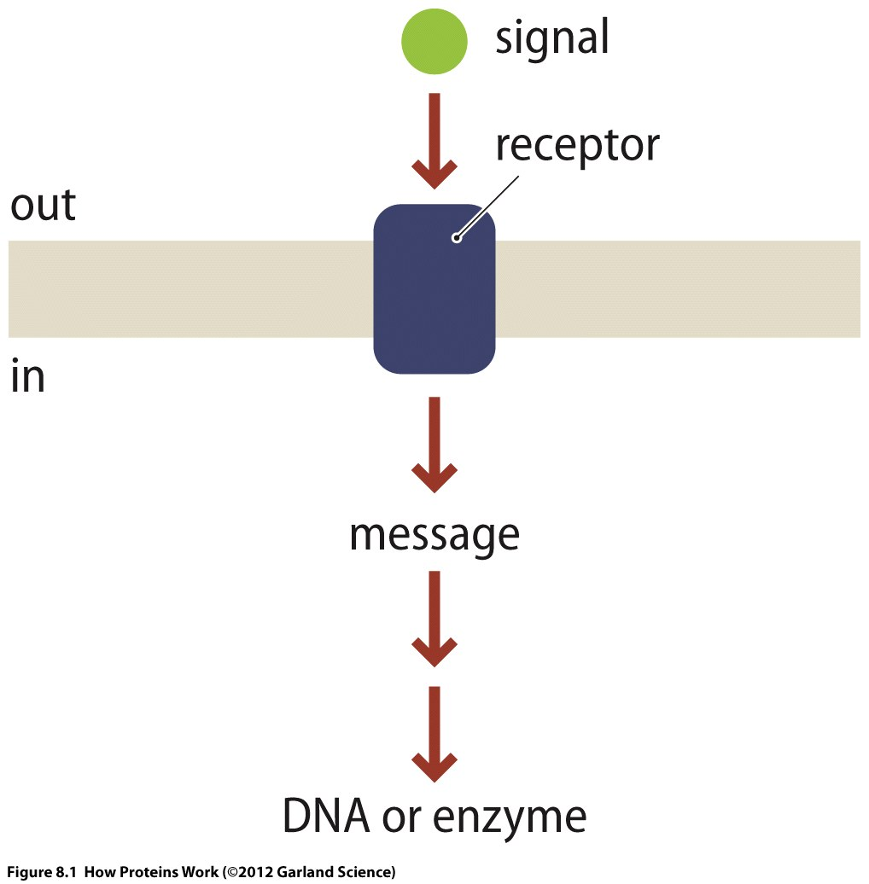
Cellular Signalling in a Nutshell
Response to extracellular signal
Notes:
Response to an extracellular signal can be gene expression, secretion of proteins, cell differentiation, apoptosis,……..

Slide 4
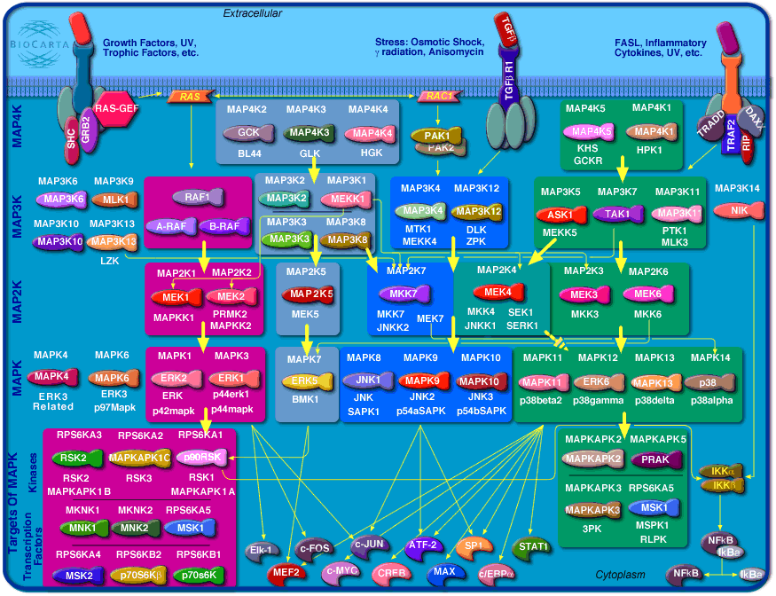
Notes:
Cells permanently receive different signals which are received by receptors located in the cell membrane. These receptors can be specific for chemical signals, voltage, heat, mechanical signals.
Receptors transmit the signal across the cell membrane through conformational changes which trigger and intracellular signaling cascade. Mediators of this signaling cascade are proteins which can switch between active and inactive states.

Slide 5
How do proteins transmit a signal?
Noncovalent binding of a ligand
Chemical modification
Both events can lead to conformational changes and/or to formation of new interaction sites

Slide 6
Active conformation
Free Energy
Inactive conformation
Conformational coordinate
Free energy of the inactive state is lower. Protein primarily adopts the inactive conformation
Protein binds a ligand or is chemically modified
Free energy landscape changes and the active conformation becomes preferred
Protein primarily adopts the active conformation

Slide 7
Kinases

Slide 8
Kinases are enzymes which catalyze the transfer of a phosphate group from ATP to a substrate

Slide 9
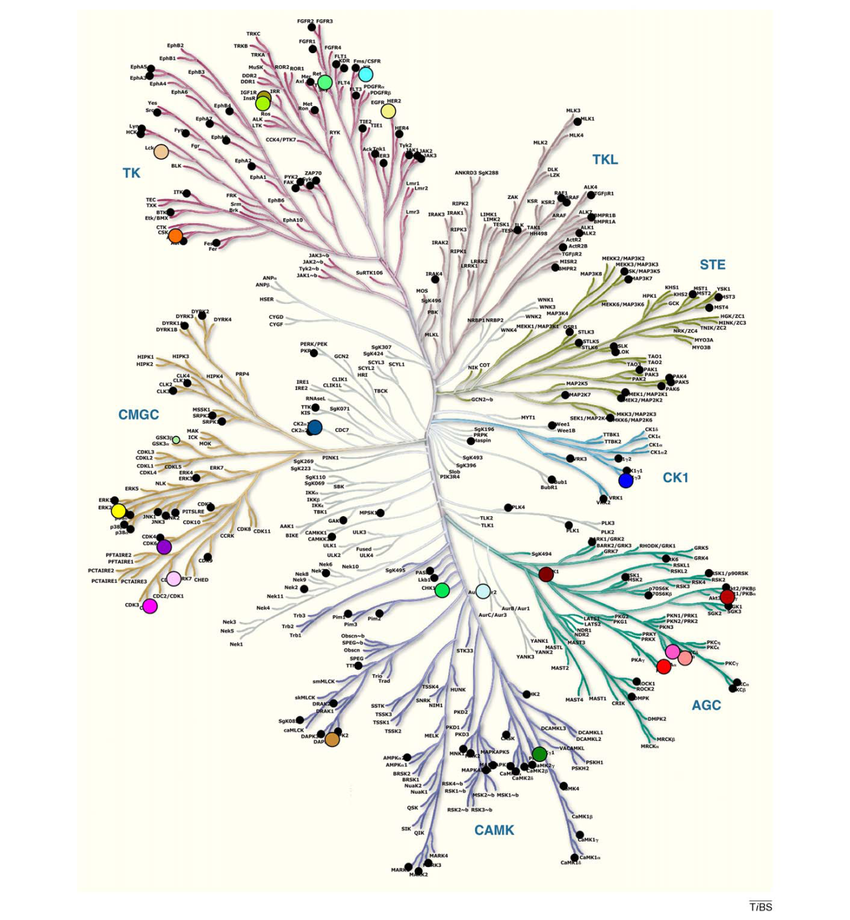
Kinases are one of the largest protein families in the human genome ( > 500 )
They all share the same fold and all have an ATP binding site
Despite these similarities they can be highly specific in the substrates they phosphorylate.

Slide 10
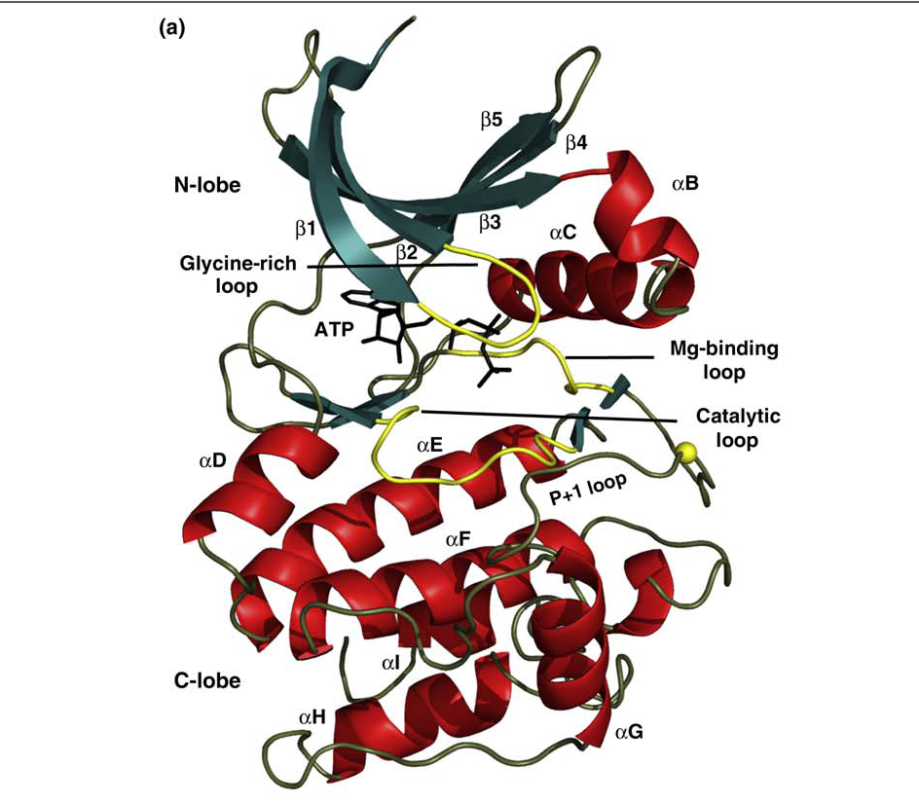
Kinases
Kinases consist of a N-lobe, which contains beta-sheets and a C-lobe which is primarily alpha-helical.
The ATP binding site is formed between these two domain.

Slide 11
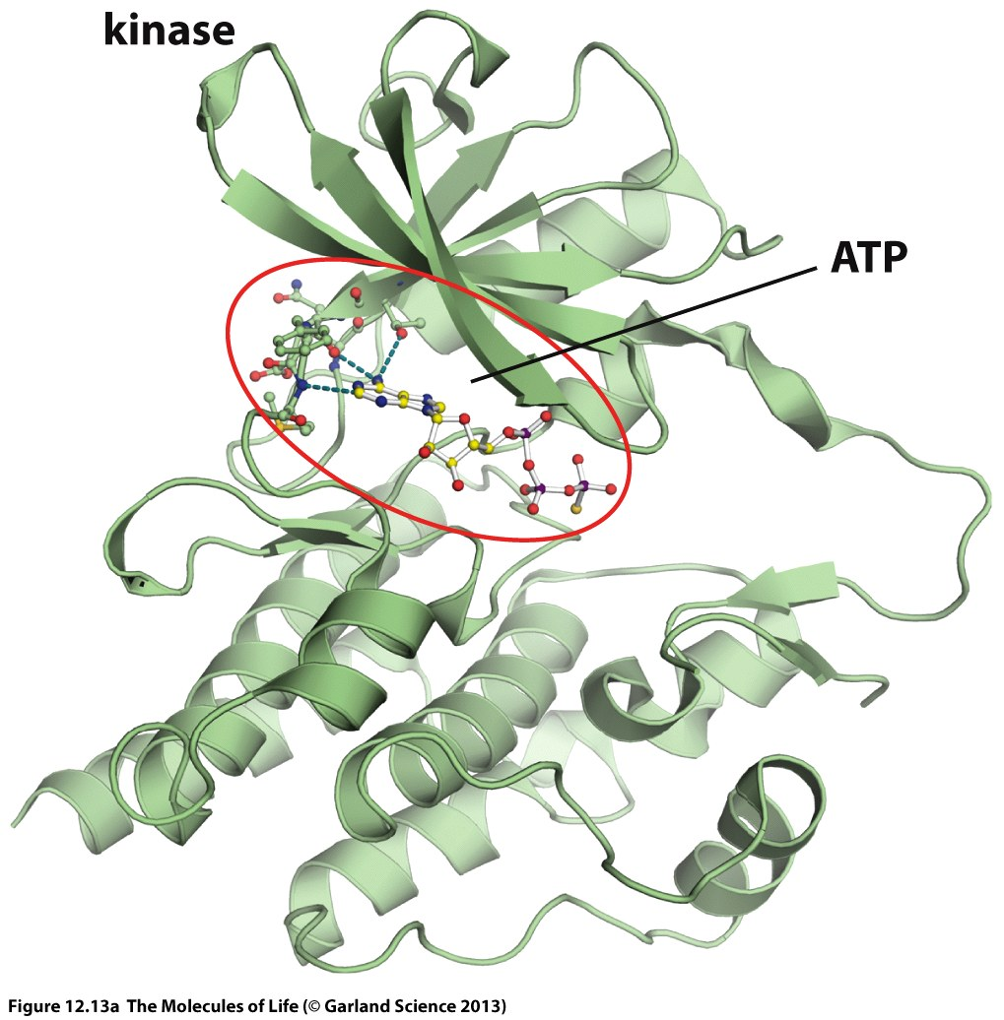
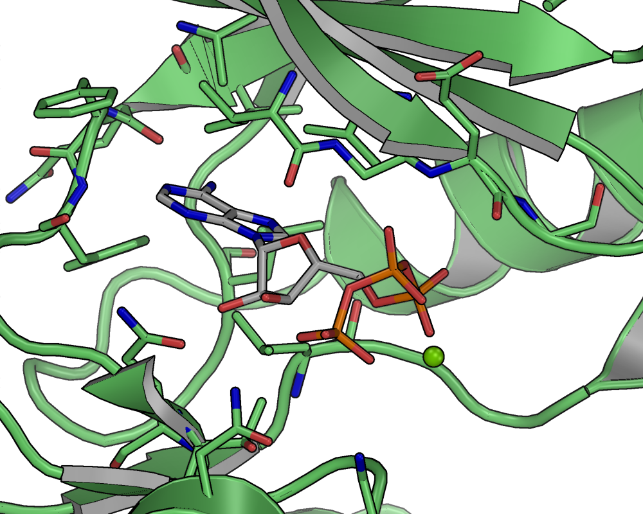
Notes:
Pymol View?

Slide 12
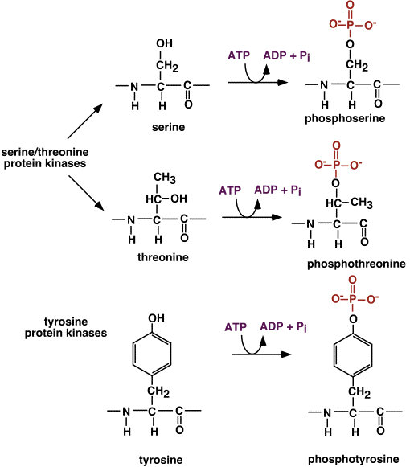
Notes:
Kinase transfer a phosphate group to residues containing an OH-group. These residues are serine, threonine and tyrosine.

Slide 14
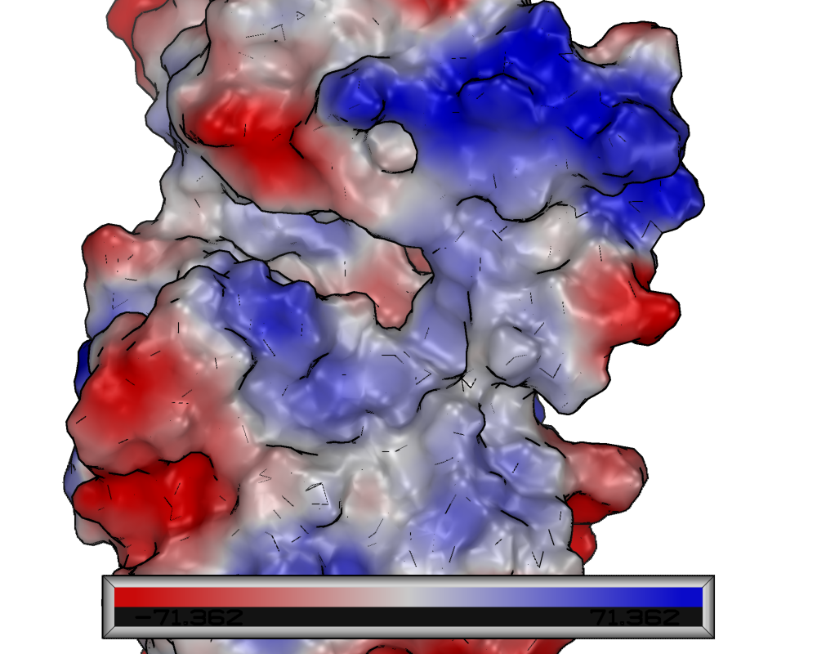
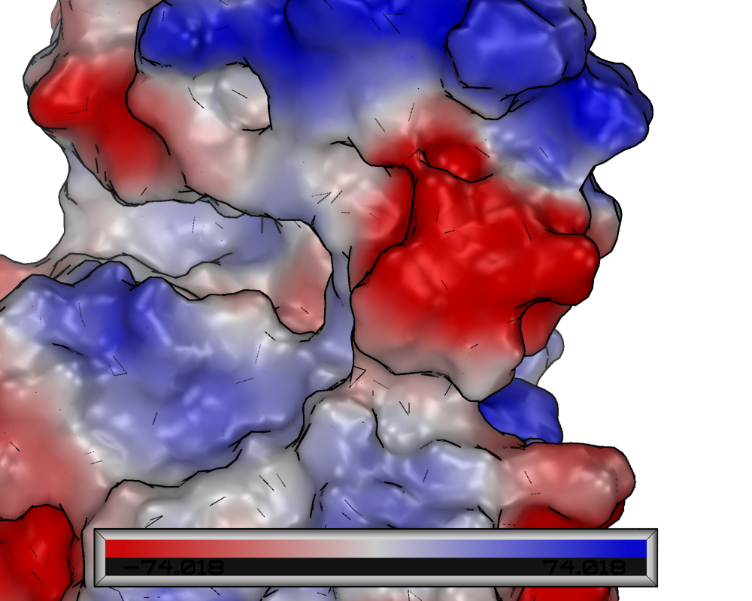
Electrostatic Surface Potential with and without Phosphorylation
Notes:
Phosphorylation creates a negative charge at a position where usually a neutral amino acid resides (Ser,Thr,Tyr).

Slide 15
Phosphorylation of a protein can lead to:
Conformational change -> Transition from active to inactive or inactive to active state
Conformational change -> Formation of a new interaction site
Formation of a new interaction site without significant conformational change
Notes:
Important for many proteins, but especially for kinases themselves

Slide 16
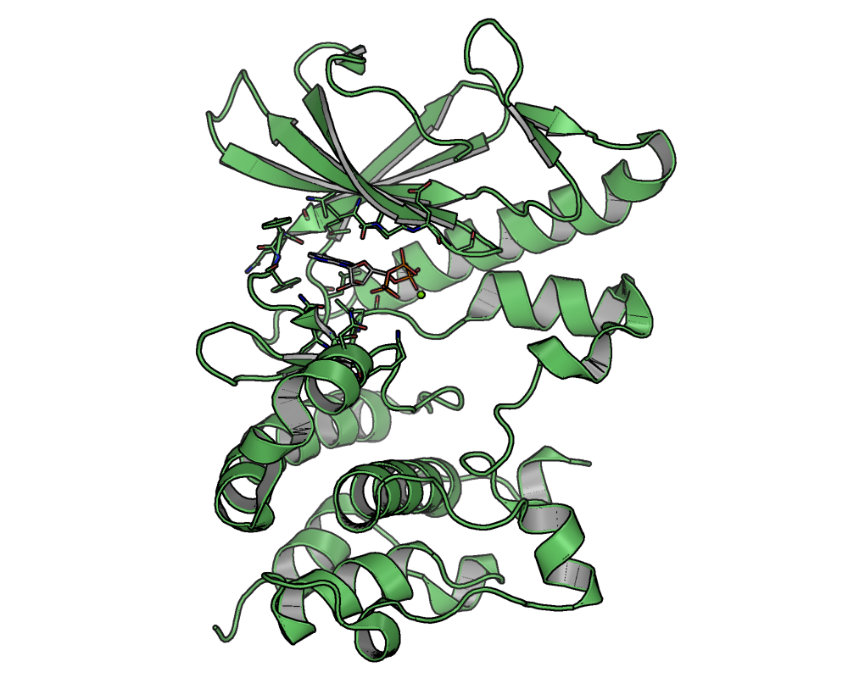
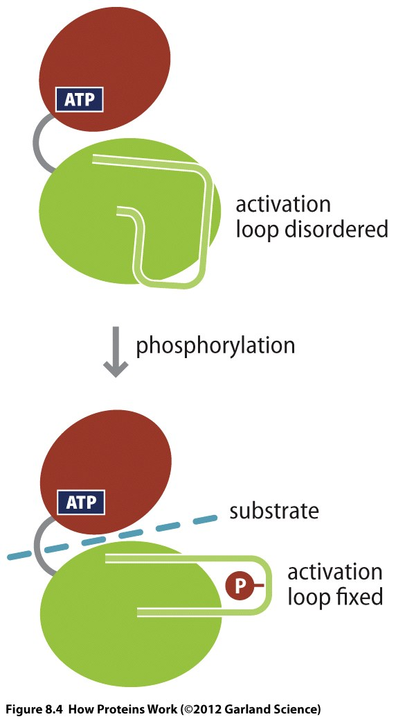
Notes:
Most kinases are activated via phosphorylation.
The phosphorylation site(s) residue in a loop region which is called the activation loop.
The activation loop is disordered when the kinase is not phosphorylated. In this conformation the kinase is inactive.
Phosphorylation leads to a conformational change in the activation loop which switches the kinase into an active state.

Slide 17
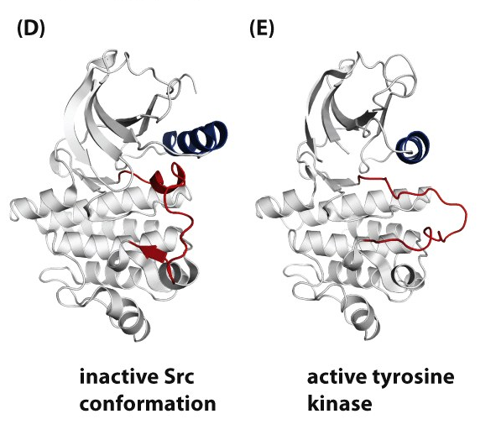

Slide 18
Kinase + ATP
Transfer of phosphate group
to another protein
phosphorylated protein can
interact with binding partner
Notes:
The activated kinase now can phosphorylate other proteins.
Other proteins can again be kinases which then are activated or proteins which need phosphorylation to interact with a binding partner.

Slide 19
Kinases are key players in the regulation of all cell mechanisms.
For regulation it is essential that signals can be turned on but also turned off again.
Kinases have a counterpart which catalyze the dephosphorylation of protein residues. This enzymes are called phosphatases.
Proper control over activity of cellular signalling pathways is essential for normal cell function.

Slide 20
B-Raf is involved in the regulation of cell growth

Slide 21
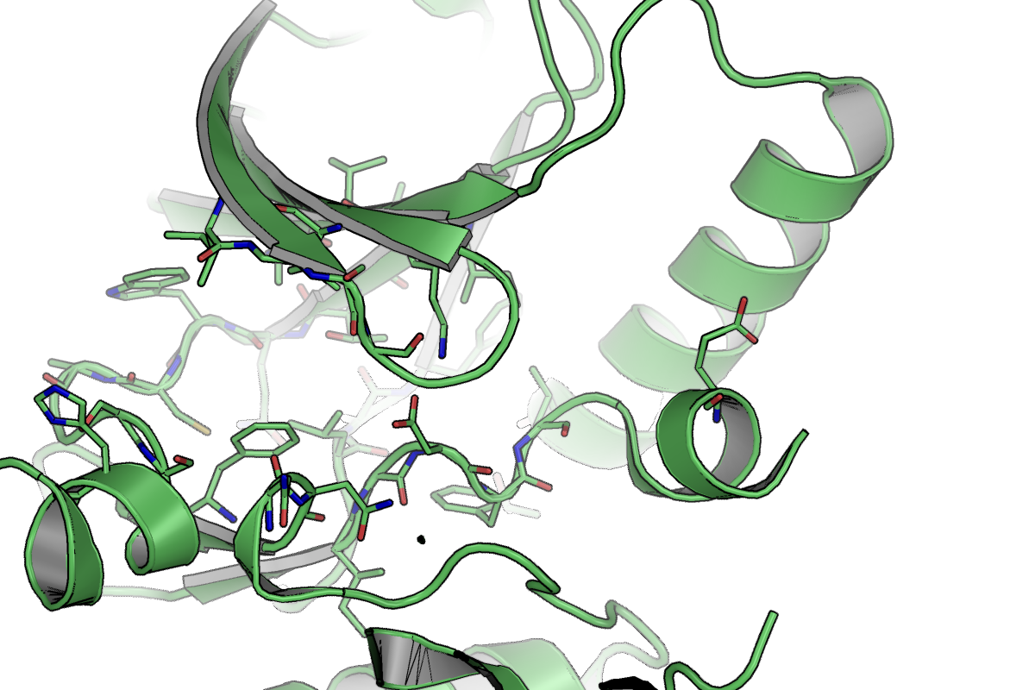
B-RAF V600E
V600E is a mutation from valine to glutamic acid in the activation loop of B-Raf.
The mutation to a charged amino acid mimics the effect of phosphorylation and leads to activation of the kinase.
Unlike in the case of phosphorylation, the activation is permanent and not reversible by phosphatases.

Slide 22
Permanent activation of B-Raf leads to uncontrolled cell proliferation (Cancer).

Slide 23
B-Raf mutations occur in different types of cancer
Inhibition of B-Raf in patients with mutated B-Raf has therefore been identified as a therapeutic concept.
Disease/Symptom
Molecular Mechanism
Identify a Way to Influence the Molecular Mechanism
Cancer
Understand the cause for uncontrolled cell growth (B-Raf mutation)
Design an inhibitor for B-Raf

Slide 24
Kinase + ATP
Kinase + Inhibitor which
blocks ATP binding site
Target protein cannot interact
with binding partner
Notes:
All kinases depend on ATP
If the the ATP binding site is blocked by an inhibitor, the kinase is inactive and not able to phosphorylate other proteins

Slide 25
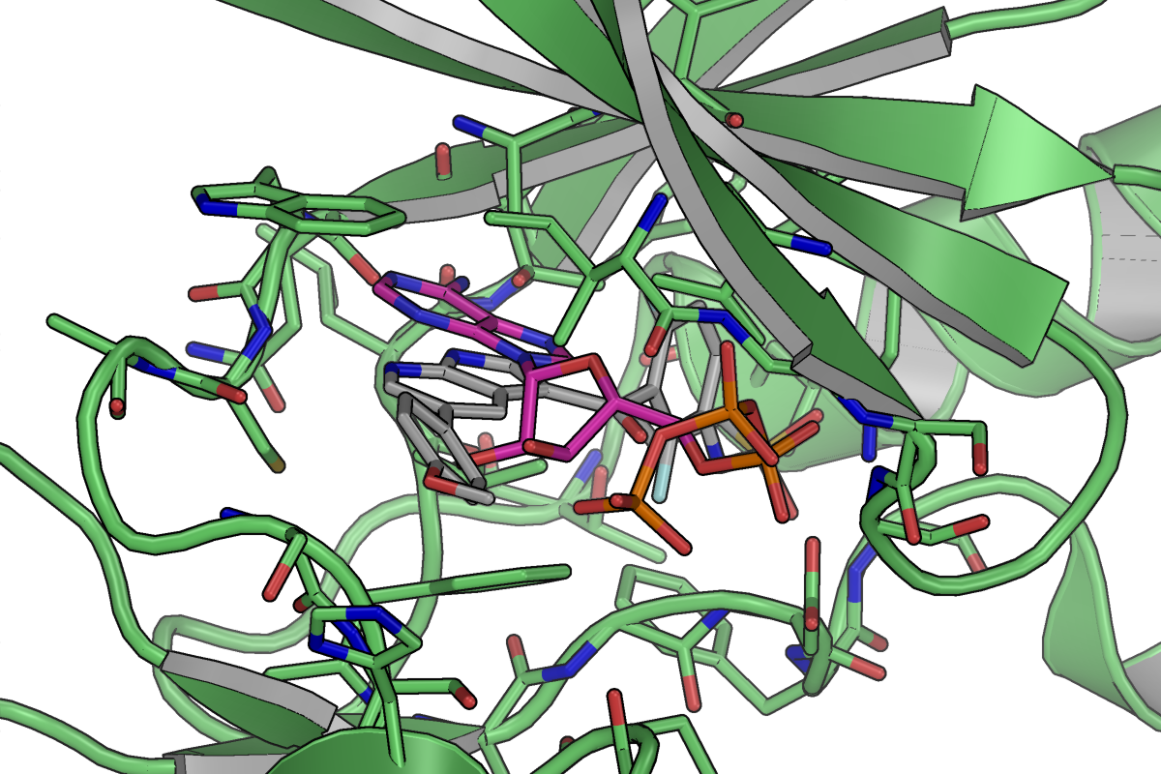

Slide 26
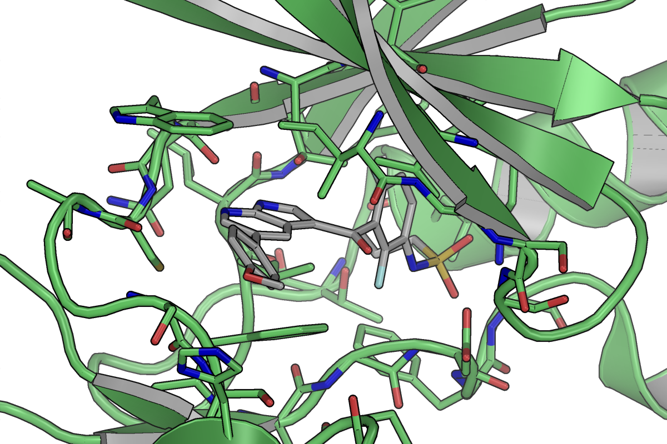
Vemurafenib
Approved for treatment of melanoma

Slide 27
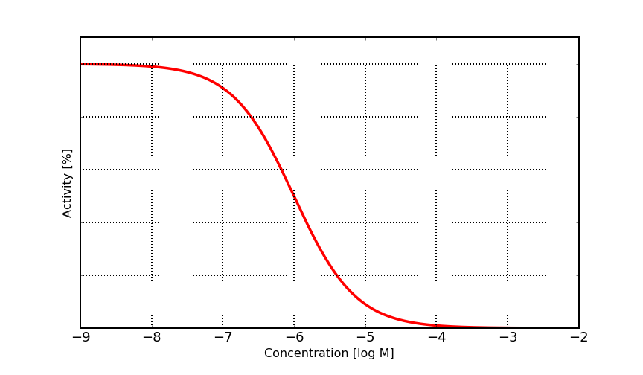
Dose Response Curve for Competitive Enzyme Inhibition
Notes:
Mode of action: Inhibition

Slide 28
Many disease states and symptoms are associated with dysregulated signal transduction pathways, e.g. permanent activation.
Kinases are involved in all cellular signaling pathways and therefore represent a very often targeted class of drug targets.
Challenges are the selectivity and the competition with ATP which is present in high amounts in the cell.
>500 kinases in the human genome
All share an ATP binding site

Slide 29
Examples for approved kinase inhibitors
Dasatinib
Imatinib
Erlotinib
Ibrutinib

Slide 30
G-Protein Coupled Receptors
(GPCR)

Slide 31
GPCRs
The G protein-coupled receptor (GPCR) superfamily comprises the largest and most diverse group of proteins in mammals.
Synonym: “seven-transmembrane” (7-TM), “serpentine” receptors, heptahelical receptors, serpentine receptor, and G protein–linked receptors (GPLR).
The human genome encodes >800 GPCRs.

Slide 32
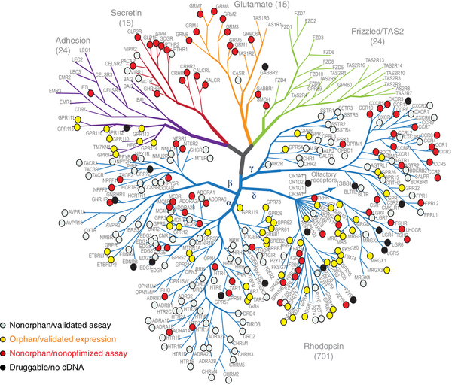

Slide 33
GPCRs
GPCRs are involved in information transfer (signal transduction) from outside the cell to the cellular interior.
GPCRs are responsible for every aspect of human biology from vision, taste, sense of smell, sympathetic and parasympathetic nervous functions, metabolism, and immune regulation to reproduction.
~45% of all pharmaceutical drugs are known to target GPCRs.

Slide 34
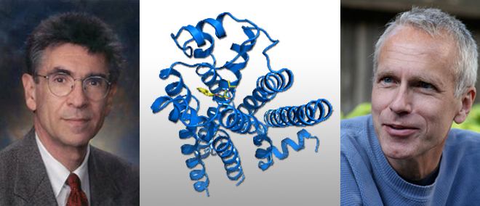
Robert Lefkowitz and Brian Kobilka: the 2012 Nobel Prize in Chemistry for groundbreaking discoveries that reveal the inner workings of an important family of receptors: G-protein–coupled receptors.

Slide 35
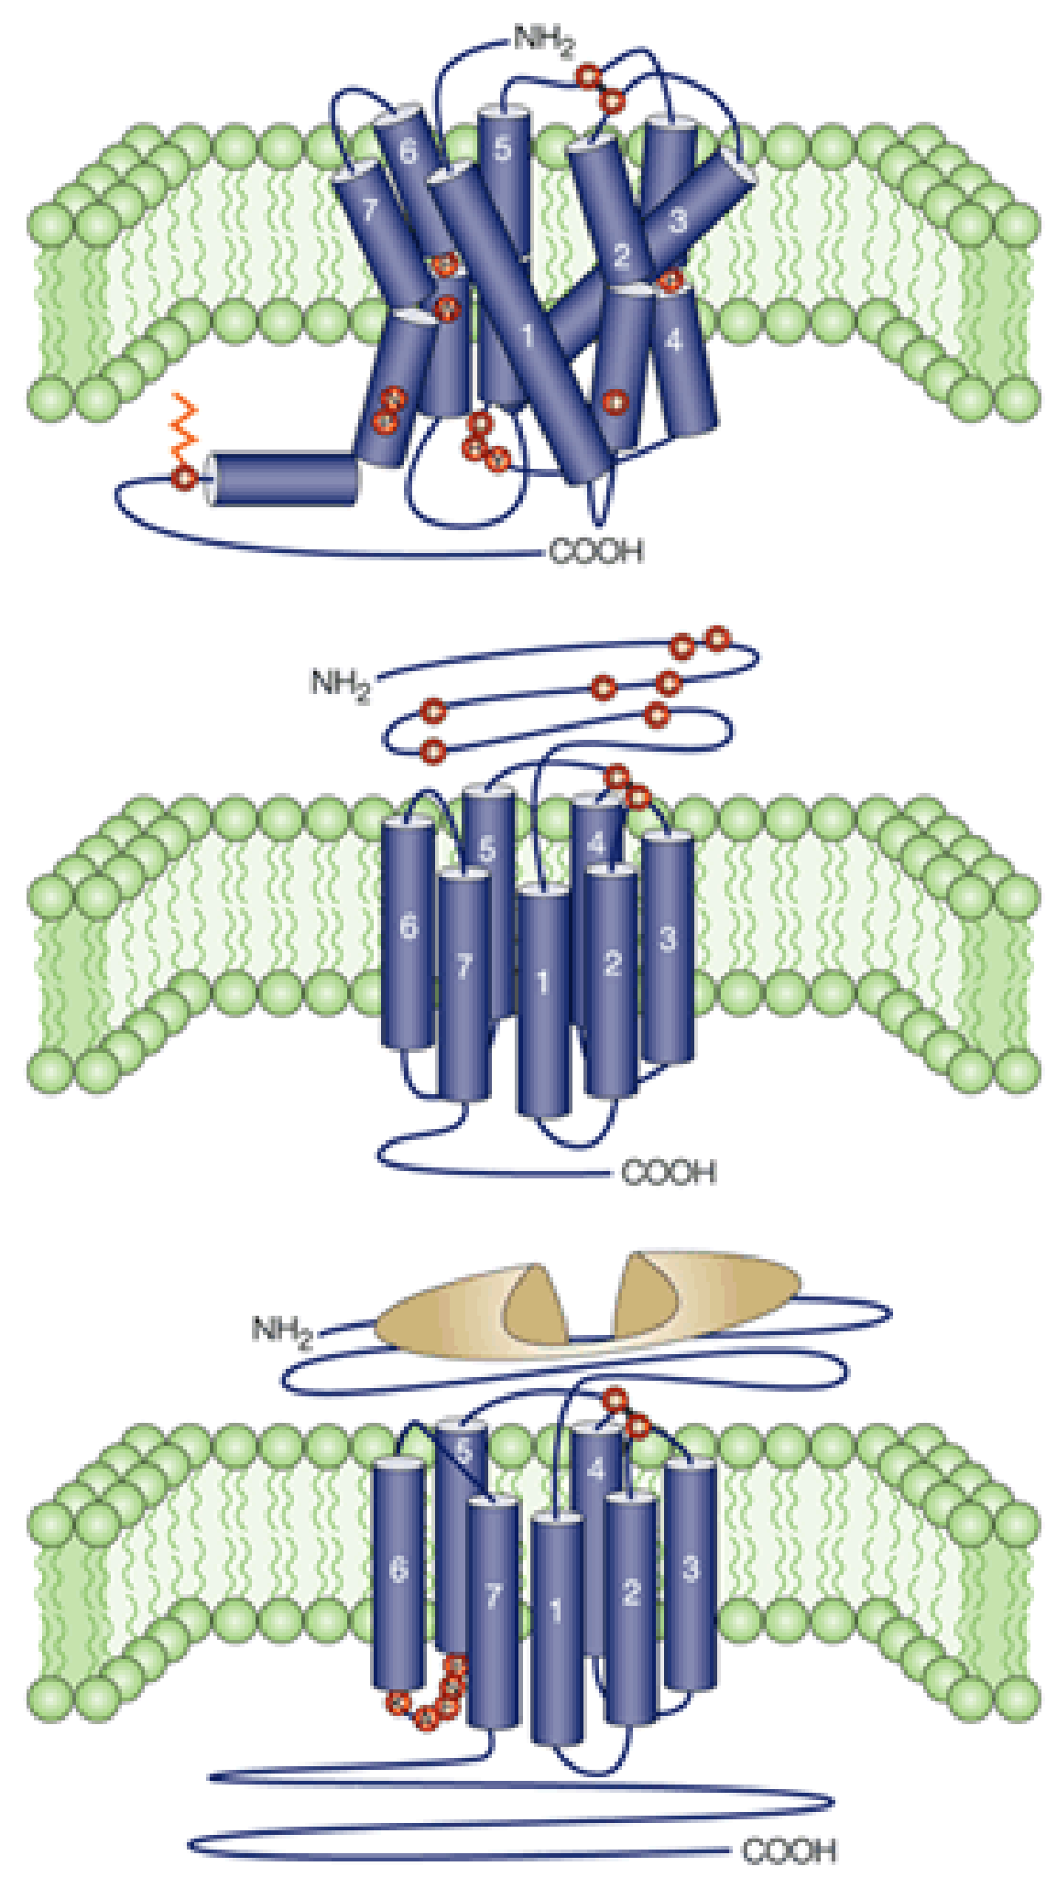
GPCRs can be subdivided into classes. The most important are class A, B and C type GPCRs
Class A GPCRs only have a short N-terminal extracellular part. Physiological ligands bind within the 7TM region
Class B GPCRs contain a larger extracellular part which is important for ligand recognition.
Class C GPCRs contain a large extracellular domain containing the ligand binding site. Upon ligand binding the extracellular domain undergoes a conformational change which triggers signalling.
Class A
Class B
Class C
Nature Reviews, Drug Discovery

Slide 36
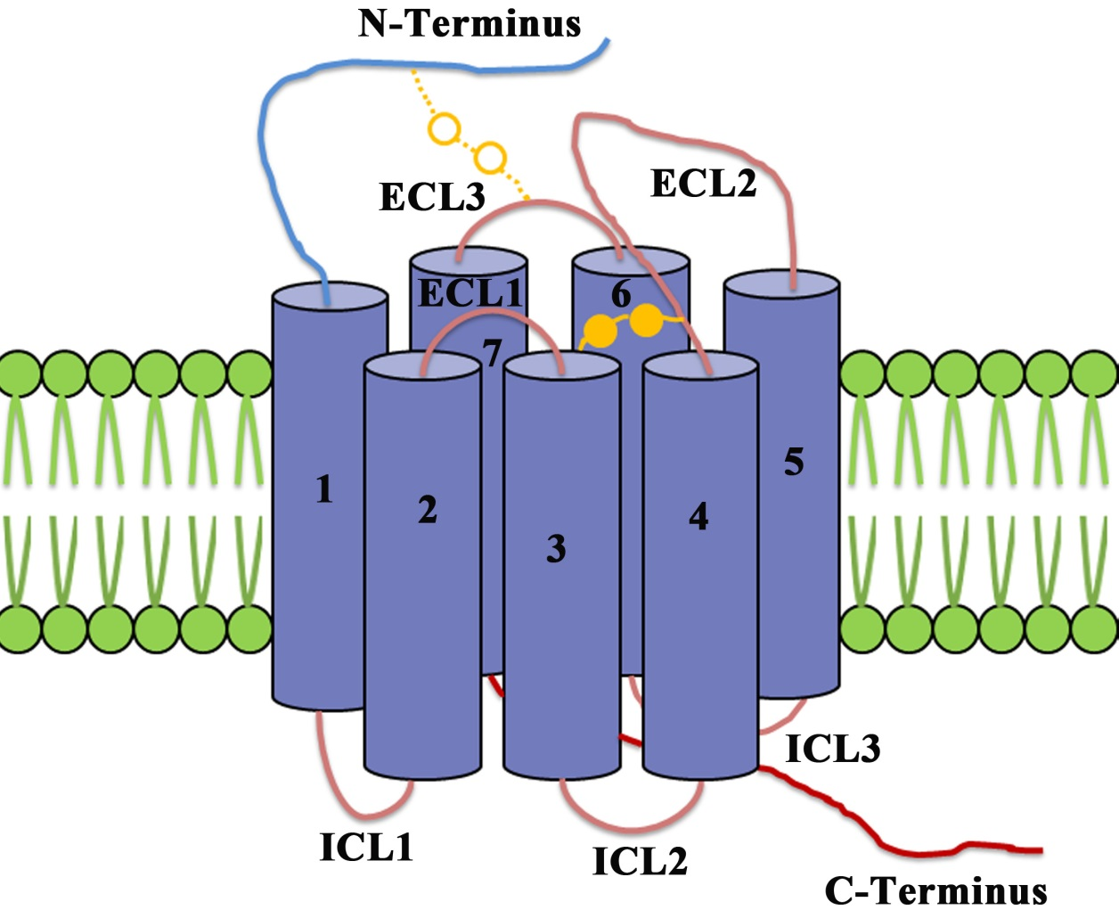
Canonical Structure of Class A GPCRs

Slide 37
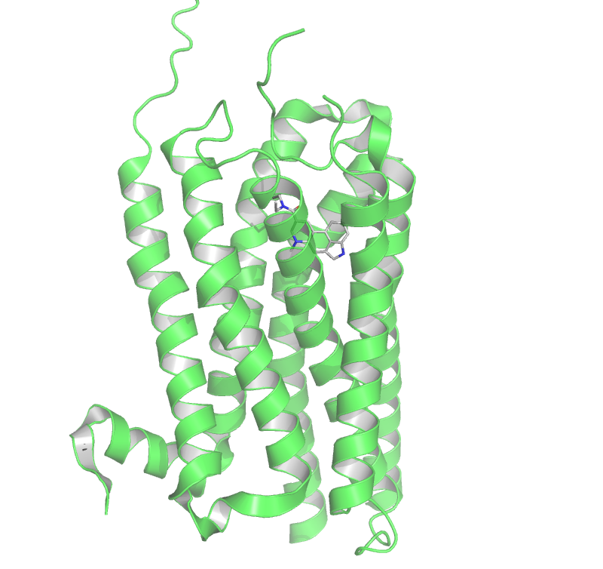
Class A GPCR Example 5HT2C
5-Hydroxytryptamine (Serotonin)
Lysergic acid diethyl amide (LSD)
37

Slide 38
Signal molecules/ Ligands of GPCRs
GPCRs interact with a number of ligands ranging from photons, ions, amino acids, odorants, pheromones, eicosanoids, neurotransmitters, peptides, proteins, and hormones.
Nevertheless, for the majority of GPCRs, the identity of their natural ligands is still unknown, hence remain orphan receptors.

Slide 39
Signal molecules
Biogenic amines: Adrenaline, noradrenaline, dopamine, 5-HT, histamine, acetylcholine
Amino acids and ions: Glutamate, Ca²⁺, GABA
Lipids : PAF, prostaglandins, leukotrienes, anandamine

Slide 40
Signal molecules…
Peptides / proteins :
GnRH, angiotensin, bradykinin, thrombin, bombesin, glucagon, calcitonin, vasoactive intestinal peptides, PTH, FSH, LH, TSH
Nucleotides : Adenosine nucleotides, adenine nucleotides, uridine nucleotides
Others : Light, odorants, pheromones, opiates

Slide 41
Physiological roles
Visual sense: Rhodopsin
Sense of smell: Olfactory receptor
Behavioral and mood regulation: Serotonin, dopamine, GABA and glutamate
Immune system activity and inflammation: Chemokine receptors, histamine receptors
ANS transmission: β adrenergic receptors
Apoptosis

Slide 43
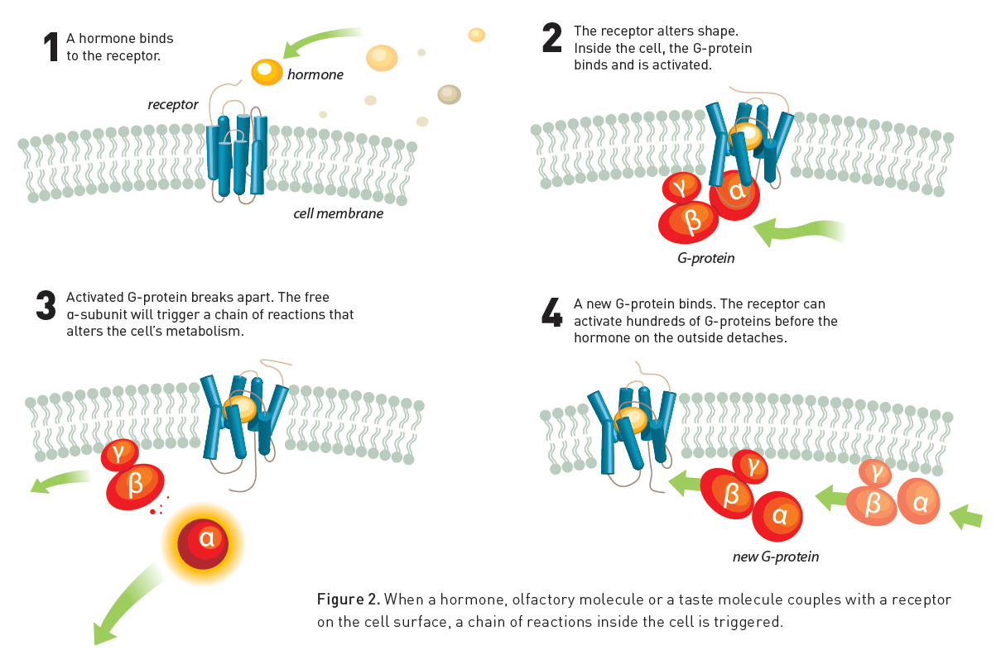

Slide 44
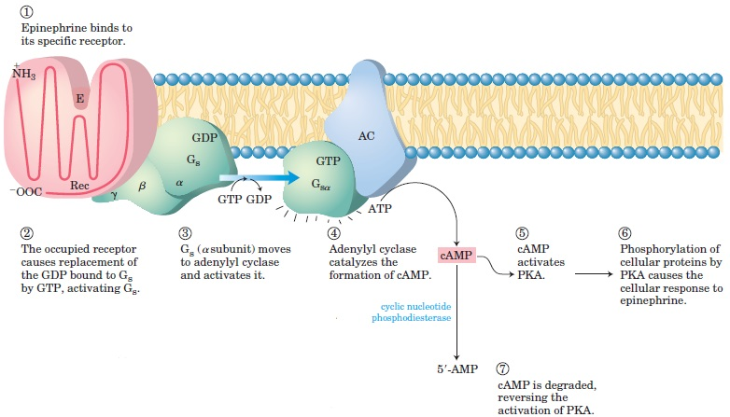

Slide 45
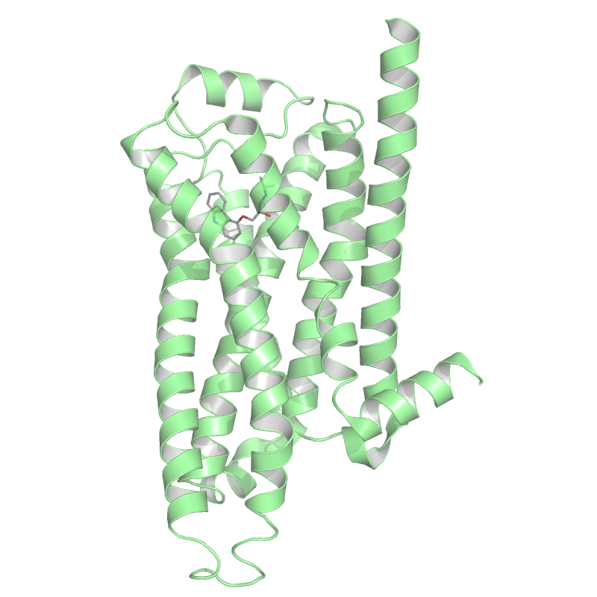
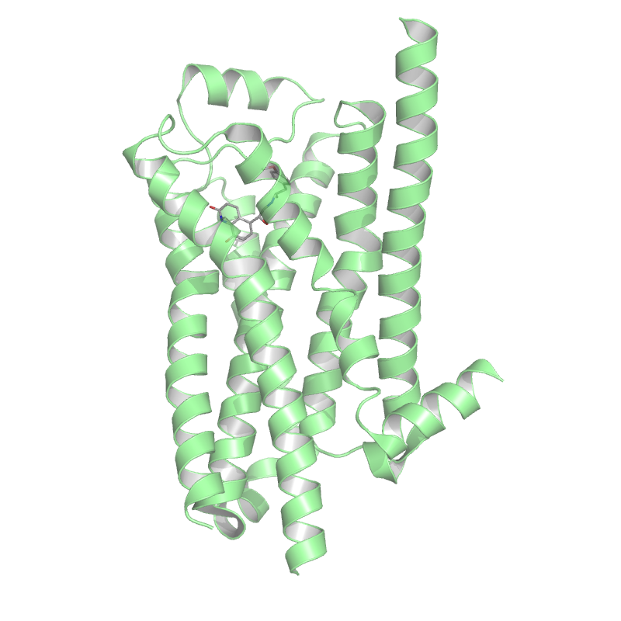
Inactive conformation
Active conformation

Slide 46
Active conformation
Free Energy
Inactive conformation
Conformational coordinate
Free energy of the inactive state is lower. GPCR primarily adopts the inactive conformation
GPCR binds a ligand. Free energy landscape changes and the active conformation becomes preferred
GPCR primarily adopts the active conformation

Slide 47
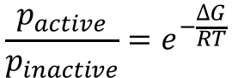
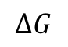
Active conformation
$$\frac{p_{active}}{p_{inactive}}=e^{−\frac{∆G}{RT}}$$
Free Energy
$$∆G$$
The free energy difference between the active and inactive state defines their relative population.
If the free energy difference is small, GPCRs have a basal activity, which means they are signaling to a certain extend also in the absence of a an agonistic ligand.

Slide 48
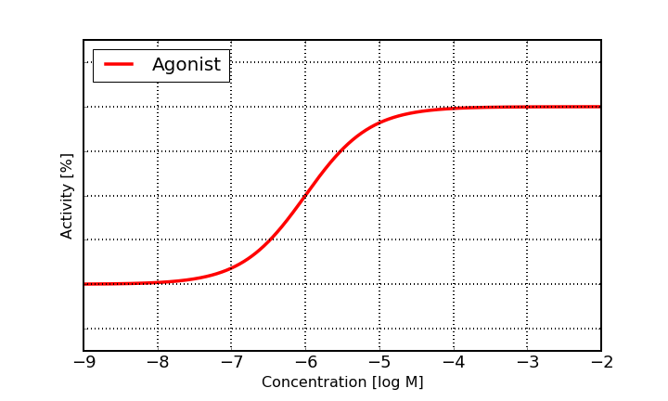
Activation by an agonistic ligand
Ligand
Basal activity

Slide 49
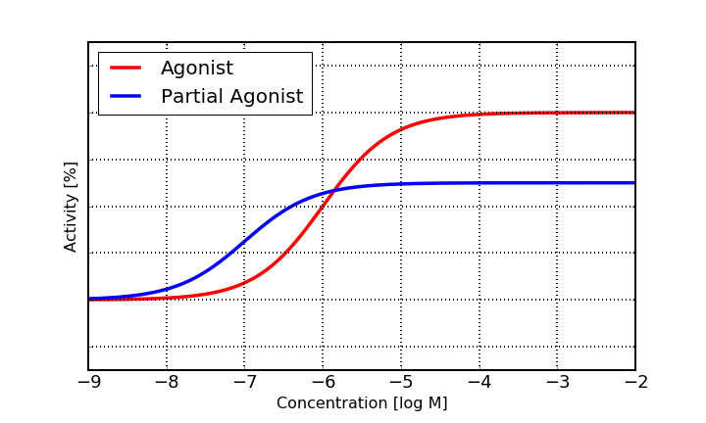
Activation by a partial agonistic ligand
Ligand
Basal activity

Slide 50
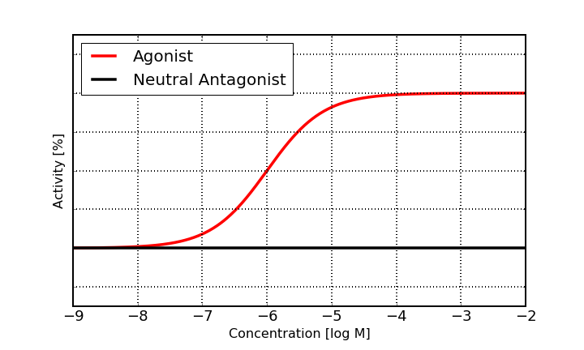
Inhibition by a neutral antagonistic ligand
Ligand
Basal activity

Slide 51
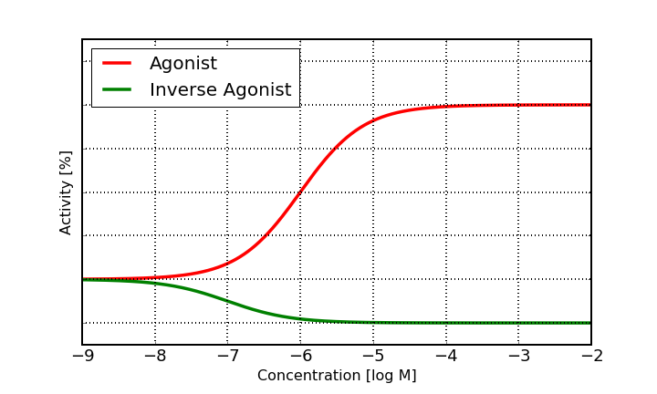
Inhibition by an inverse agonistic ligand
Ligand
Basal activity

Slide 52
Endogenous Ligand
Agonistic Ligand
Orthosteric Site
Signal

Slide 53
Allosteric Modulator
Endogenous Ligand
Altered signal
No Signal
Allosteric Site

Slide 54
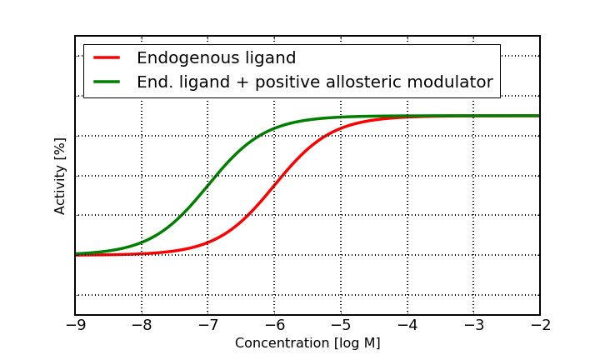
Notes:
Some allosteric modulator induce a conformational change in the orthosteric site which leads to a higher affinity for the endogenous ligand.
The consequence is a left shift of the dose response curve which means that the receptor activates already at lower concentrations of endogenous ligand

Slide 55
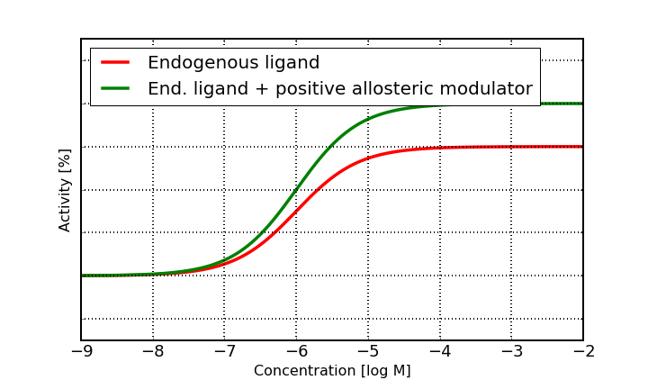
Notes:
Positive allosteric modulation can also mean that the response/activity is increased compare to the endogenous ligand alone.

Slide 56
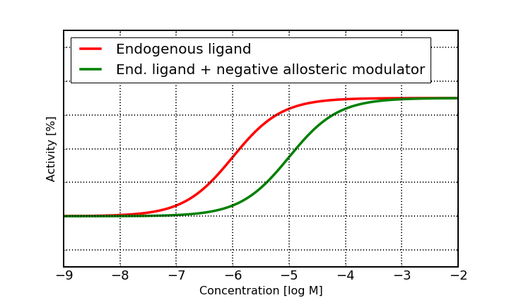

Slide 57
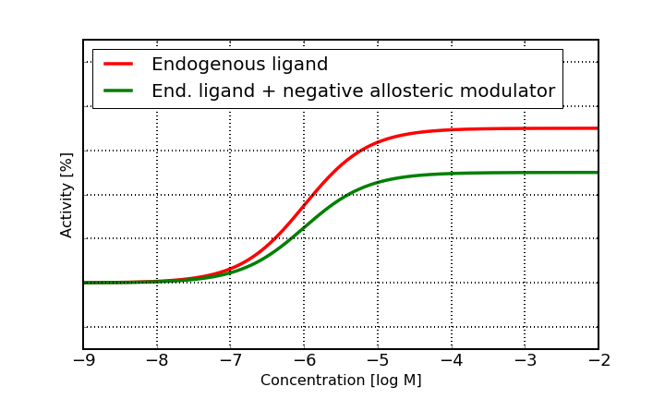

Slide 58
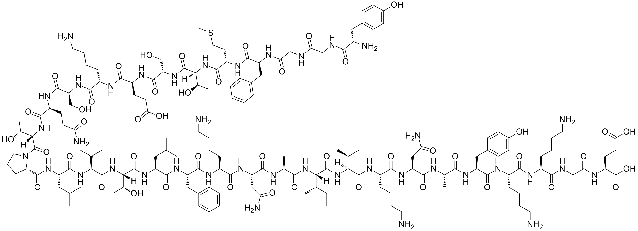
Natural ligand
β-endorphin
Histamine
Dopamine
Serotonin (5-HT)
Drugs
Claritin®
(Loratadine)
H1 antagonist
Zyprexa®
(Olanzapine)
D1/D2 inverse agonist
Sansert®
(Methysergide)
5-HT antagonist
Fentanyl
µ-Opiod agonist

Slide 59
Protein flexibility is essential for protein function
Conformational equilibria can be altered by noncovalent binding of ligands or chemical modification of the protein, e.g. phosphorylation
Kinases are enzymes which transfer a phosphate group to another protein (or other substrates). This is and important mechanism to switch cellular signals on and off. Dysregulation of kinases can lead to severe conditions, e.g. cancer. Therefore kinases are intensively researched drug targets.
GPCRs are import membrane proteins which transmit signals from outside of the cell to the interior. Almost half of all approved drugs act on GPCRs and still a lot of research and drug discovery programs aim at modulating the function of GPCRs. Modulation of GPCRs is not restricted to inhibition but be agonistic, partial agonistic or via allosteric modulation.

